Slide 1


ITC — Information Technology Colleague
Digital Egypt Pioneers Initiative
GRADUATION
PROJECT
Powerful • Modern • Premium
Testing
QA Engineering
2025 / 2026
CAI4_SWD6_S6
Software Testing
Appreciation to the Initiative Management & ITC

Slide 2
Overview
AGENDA
What we'll cover today
This presentation covers the quality testing project for the Booking.com platform, starting from the testing challenges, through the methodology followed and the execution of manual and automated test cases, all the way to the final results across 17 functional modules.
01 Introduction
02 Project Overview
215
178
7
30
03 Testing Challenges
04 QA Approach
Test Cases
Passed
Failed
Blocked
05 Test Coverage
06 Conclusion

Slide 3
Project Overview
Team · Tech Stack · Supervisor
The Team
Booking.com QA testing
Project Name
Malak Anwer
Basma Mostafa
M
B
Team Leader
QA Engineer
Tech Stack
Ziyad abdeldayem
Nouran mohamed
Selenium WebDriver · Java · TestNG · Postman · Mailsaur · Excel
Z
N
QA Engineer
QA Engineer
Supervisor
Karim nasr
Sameh Atef
Basil khalid
K
S
QA Engineer
QA Engineer
Yousef Mohamed
Y
QA Engineer

Slide 4
Overview
Project
01
Manual Testing
Designing and executing 215 manual test cases distributed across 17 functional modules over two complete test cycles.
Overview
Booking.com is one of the largest travel platforms globally, which made testing it a real challenge requiring comprehensive coverage of a large number of interconnected functional modules, in the absence of any prior test case documentation.
02
Automation Testing
Building an automated test suite using Selenium WebDriver, Java, and TestNG that covers the most prominent user flows.
03
Bug Reporting
Tracking and documenting discovered bugs with severity and priority classification, along with delivering a comprehensive coverage report at the end of each test cycle.

Slide 5
Testing
1. Wide Coverage
2. Sign-in Using OTP
Challenges
3. Blocked Features
Wide Coverage
Sign-in
Blocked Features
The Booking.com platform contains dozens of interconnected functional flows, making defining the test scope and ensuring comprehensive coverage within the available time a real challenge.
The OTP mechanism brought automated login testing to a complete halt — the script cannot pass the verification screen, which blocked all test cases built on an authenticated user session.
30 test cases could not be executed due to features unavailable in the testing environment, which affected coverage completeness and forced the team to document them as Blocked rather than ignore them.

Slide 6
QA Approach
Approach
Main Solution
Advantages
Designing and executing two test cycles of 215 manual test cases distributed across 17 functional modules, supported by a Selenium automated test suite covering the most prominent user flows.
Running two test cycles with clear tracking of pass, fail, and skip cases, documenting bugs with severity and priority classification, and resolving OTP issue via Mailsaur.
Technologies Used
Expected Results
Selenium WebDriver · Java · TestNG · Postman · Mailsaur · Excel
7 Bugs documented, 30 blocked test cases recorded, with a comprehensive coverage report delivered.

Slide 7
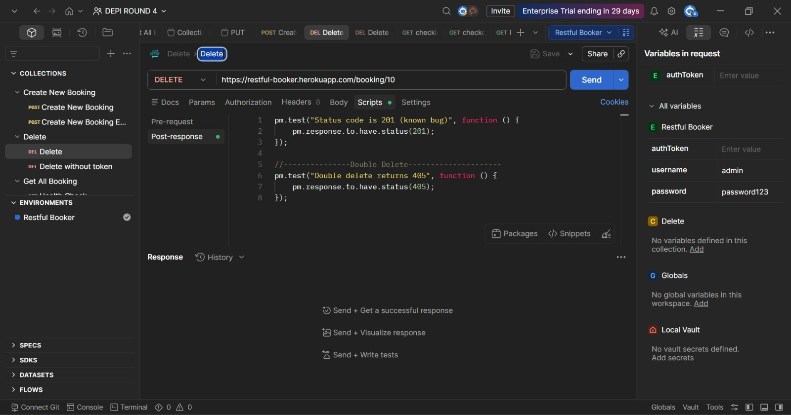
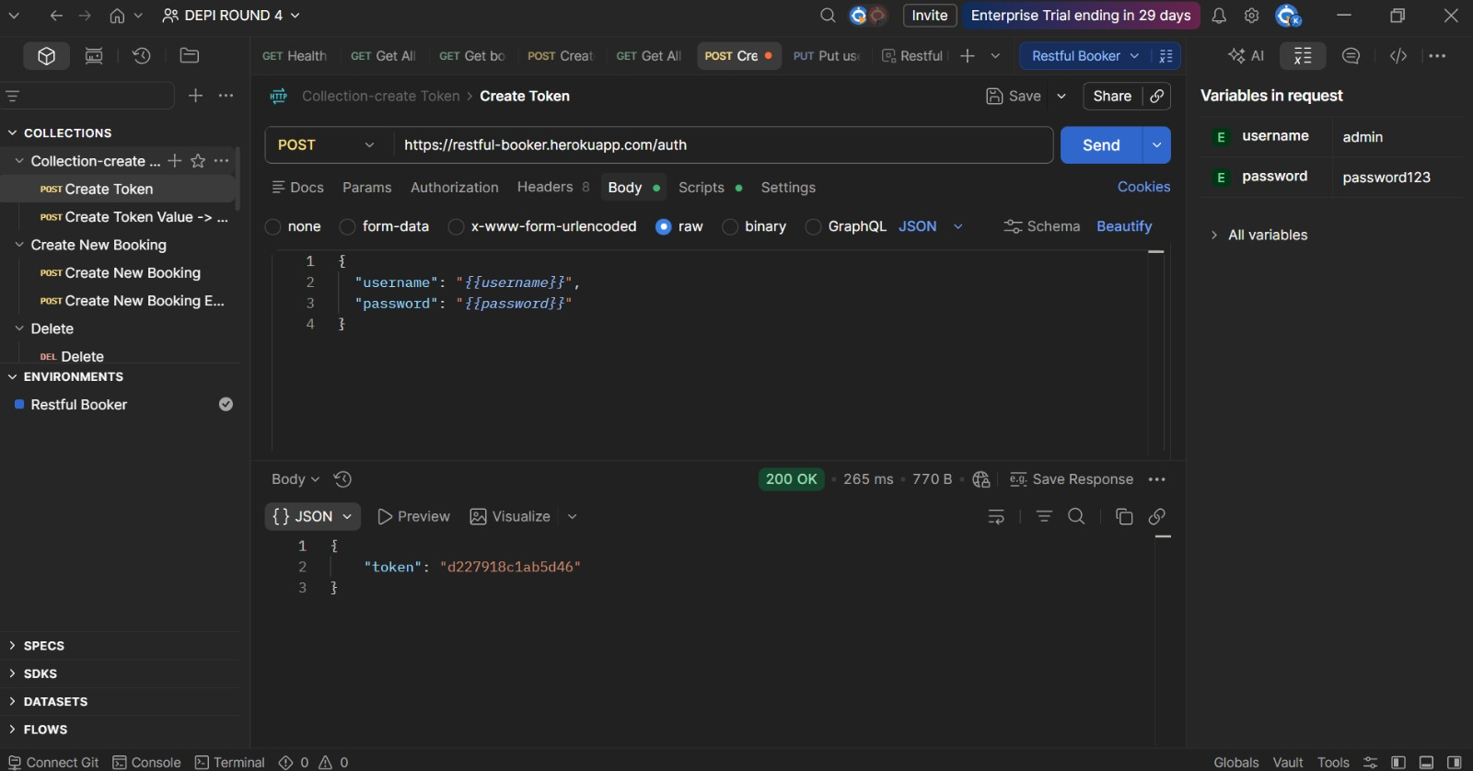
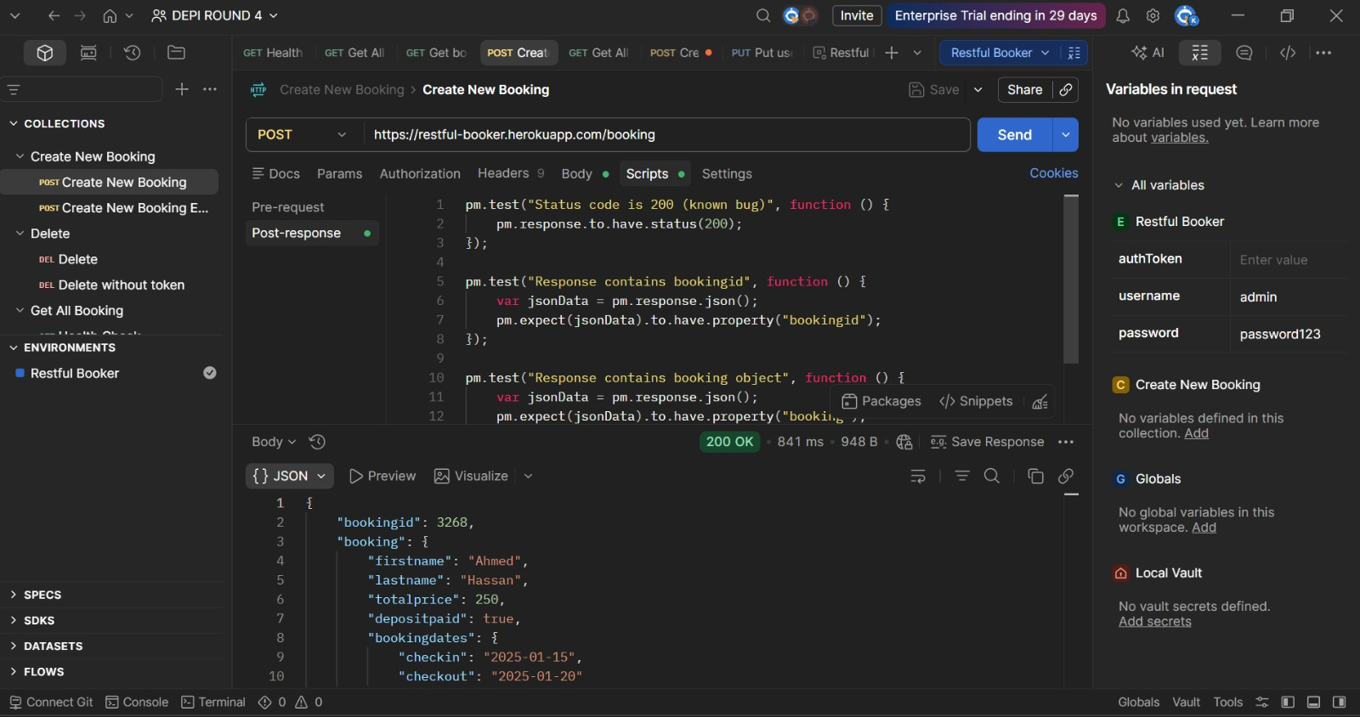
Demo &
Screenshots

Slide 8
QA Results Dashboard
Testing Team — Final Metrics
215
178
7
30
Total Test Cases
Passed
Failed
Blocked

Slide 9
Conclusion
Summary
Thank
The team succeeded in executing two complete test cycles for the Booking.com platform, covering 215 test cases, 17 functional modules, manual and automated testing using Selenium, and documenting 7 verified bugs
You!
Learnings
This project taught us how to work with real, complex platforms, and the importance of testing thoroughness and precision, with technical constraints like OTP, and building confidence through an organized team effort.
Malak Anwer— Team Leader
ITC Graduation Project
Future Work
Expanding automated test coverage, integrating with CI/CD, and adding cross-browser and cross-device testing layers..

